Slide 1
Digital Portfolio
STUDENT NAME : Jayasree D
REGISTER NO : 2428C0477
NMID : 855FABDAA7A7CA6A6214C22B5B2FE894
DEPARTMENT : BSc., Artificial Intelligence and Machine Learning
COLLEGE : KPR College of Arts Science and Research
UNIVERSITY : Bharathiar University

Slide 2
PROJECT TITLE
Conference speaker portfolio

Slide 3


AGENDA
Problem Statement
Project/Research Overview
Target Audience
Tools & Techniques
Portfolio Design & Layout
Features & Achievements
Results & Impact
Conclusion
Contact / Links
3/21/2024 Annual Review

Slide 4

PROBLEM STATEMENT
In today’s professional landscape, traditional resumes are not enough to showcase a speaker’s expertise, credibility, and impact. Conference organizers and institutions often struggle to evaluate:
Speaker’s past engagements
Core expertise and topics covered
Audience reach and feedbac
There is a strong need for a Conference Speaker Portfolio that highlights a speaker’s skills, achievements, and session outcomes in a clear and professional manner.

Slide 5

PROJECT OVERVIEW
The Conference Speaker Portfolio is a structured presentation of my:
Academic background in AI & ML
Speaking engagements at workshops, seminars, and conferences
Expertise areas (AI/ML fundamentals, applied AI, ethics in AI, GenAI)
Audience feedback and results
This portfolio serves as a digital identity for event organizers, enabling them to assess my credibility and suitability for different events.

Slide 6

WHO ARE THE END USERS?
Conference Organizers & Event Managers To evaluate the speaker’s profile, expertise, and past engagements for selecting impactful keynote and panel contributors.
Corporate & Educational Institutions For inviting guest speakers, conducting training programs, motivational talks, leadership sessions, and skill development workshops.
Students & Early-career Professionals To gain exposure to industry trends, innovative practices, and career guidance through engaging sessions.
Research & Academic Communities For knowledge exchange, academic collaborations, joint research initiatives, and expert panel discussions.
Industry Leaders & Innovators To collaborate on new projects, share insights, and exchange expertise

Slide 7

TOOLS AND TECHNIQUES
1. Presentation Tools: PowerPoint → For structured and professional slides Canva → For creative layouts and visuals Prezi → For interactive presentations
2. Collaboration Platforms: Zoom / MS Teams / Google Meet → For virtual conferences, workshops, and discussions
3. Content Hosting & Sharing: GitHub Pages → For resources and code sharing LinkedIn → For networking and professional updates Personal Website → For portfolio and speaker profile

Slide 8
PORTFOLIO DESIGN AND LAYOUT
Header → Displays name, role, specialization, and contact details with a professional design.
About Me Section → Short bio highlighting academic journey, interests, and speaking expertise.
Topics Section → Core areas of focus such as AI/ML Fundamentals, Applied ML, Ethics in AI, Generative AI.
Talks & Engagements → Showcases past conferences, seminars, workshops, and invited lectures with year and audience details.
Impact Section → Includes audience feedback, key achievements, and outcomes of sessions.
8

Slide 9
Design Elements → Uses modern UI, 3D effects, and visuals to make content more engaging and memorable.
Achievements Section → Highlights awards, recognitions, or special mentions received as a speaker.
Media & Resources Section → Provides access to slides, recordings, and publications for reference.
Contact Section → Provides email, website/LinkedIn links, and an invitation call-to-action for organizers.
.

Slide 10
FEATURES AND FUNCTIONALITY
Professional Branding → Clear identity showcasing name, expertise, and specialization in AI & ML.
Topic Highlights → Well-structured display of signature speaking areas (AI/ML, Ethics, GenAI).
Past Engagements Showcase → Section for conferences, seminars, and workshops with year, title, and audience size.
Audience Engagement → Interactive elements like Q&A sessions, live polls, and feedback forms to measure impact.
Portfolio Adaptability → Content tailored for conference organizers, corporate trainers, or academic institutions.
Visual Storytelling → Use of infographics, 3D effects, and multimedia elements to make talks more engaging.
Feedback & Testimonials → Dedicated section for audience reviews and organizer testimonials.
Resource Sharing → Easy access to slides, recordings, articles, and GitHub links.

Slide 11
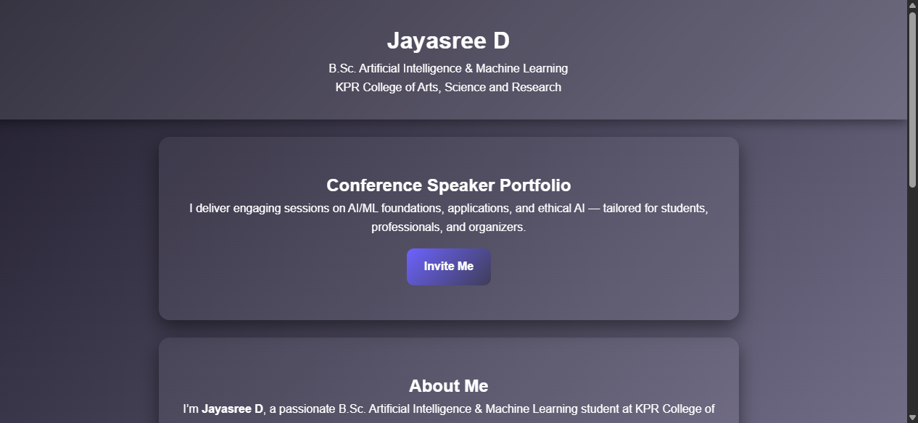

RESULTS AND SCREENSHOTS
Delivered impactful sessions and workshops on AI/ML topics
Reached and engaged hundreds of learners with positive feedback
Built a strong presence as a young and credible AI/ML speaker
3/21/2024 Annual Review
11

Slide 12
CONCLUSION
The Conference Speaker Portfolio serves as a professional showcase of my academic background, expertise, and speaking engagements.
It provides credibility and visibility to event organizers, enabling them to evaluate my skills and suitability for conferences, workshops, and seminars.
The portfolio emphasizes core strengths: AI/ML fundamentals, applied machine learning, ethical AI, and generative AI.
It demonstrates not only my knowledge but also my ability to communicate complex concepts clearly to diverse audiences.
This platform contributes to career growth, collaboration opportunities, and personal branding as a speaker.
Ultimately, the portfolio helps me become a trusted voice in the AI/ML community, creating impact through knowledge sharing and innovation.
12

Slide 13
GitHub link
https://github.com/jayasreed017/my-portfolio

